Slide 1



Chapter 5 Link Layer
Computer Networking: A Top Down Approach 6th edition Jim Kurose, Keith Ross Addison-Wesley March 2012
A note on the use of these ppt slides:
We’re making these slides freely available to all (faculty, students, readers). They’re in PowerPoint form so you see the animations; and can add, modify, and delete slides (including this one) and slide content to suit your needs. They obviously represent a lot of work on our part. In return for use, we only ask the following:
If you use these slides (e.g., in a class) that you mention their source (after all, we’d like people to use our book!)
If you post any slides on a www site, that you note that they are adapted from (or perhaps identical to) our slides, and note our copyright of this material.
Thanks and enjoy! JFK/KWR
All material copyright 1996-2012
J.F Kurose and K.W. Ross, All Rights Reserved

Slide 2
Chapter 5: Link layer
our goals:
understand principles behind link layer services:
error detection, correction
sharing a broadcast channel: multiple access
link layer addressing
local area networks: Ethernet, VLANs
instantiation, implementation of various link layer technologies

Slide 3
Link layer, LANs: outline
5.1 introduction, services
5.2 error detection, correction
5.3 multiple access protocols
5.4 LANs
addressing, ARP
Ethernet
switches
VLANS
5.5 link virtualization: MPLS
5.6 data center networking
5.7 a day in the life of a web request

Slide 4














Link layer: introduction
terminology:
hosts and routers: nodes
communication channels that connect adjacent nodes along communication path: links
wired links
wireless links
LANs
layer-2 packet: frame, encapsulates datagram
global ISP
data-link layer has responsibility of
transferring datagram from one node
to physically adjacent node over a link

Slide 5
Link layer: context
datagram transferred by different link protocols over different links:
e.g., Ethernet on first link, frame relay on intermediate links, 802.11 on last link
each link protocol provides different services
e.g., may or may not provide rdt over link
transportation analogy:
trip from Princeton to Lausanne
limo: Princeton to JFK
plane: JFK to Geneva
train: Geneva to Lausanne
tourist = datagram
transport segment = communication link
transportation mode = link layer protocol
travel agent = routing algorithm

Slide 6
Link layer services
framing, link access:
encapsulate datagram into frame, adding header, trailer
channel access if shared medium
“MAC” addresses used in frame headers to identify source, dest
different from IP address!
reliable delivery between adjacent nodes
we learned how to do this already (chapter 3)!
seldom used on low bit-error link (fiber, some twisted pair)
wireless links: high error rates
Q: why both link-level and end-end reliability?

Slide 7
Link layer services (more)
flow control:
pacing between adjacent sending and receiving nodes
error detection:
errors caused by signal attenuation, noise.
receiver detects presence of errors:
signals sender for retransmission or drops frame
error correction:
receiver identifies and corrects bit error(s) without resorting to retransmission
half-duplex and full-duplex
with half duplex, nodes at both ends of link can transmit, but not at same time

Slide 8
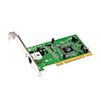
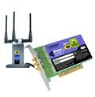


Where is the link layer implemented?
in each and every host
link layer implemented in “adaptor” (aka network interface card NIC) or on a chip
Ethernet card, 802.11 card; Ethernet chipset
implements link, physical layer
attaches into host’s system buses
combination of hardware, software, firmware
application
transport
network
link
cpu
memory
link
physical
host
bus
(e.g., PCI)
controller
physical
transmission
network adapter
card

Slide 9

Adaptors communicating
datagram
datagram
controller
controller
sending host
receiving host
datagram
frame
sending side:
encapsulates datagram in frame
adds error checking bits, rdt, flow control, etc.
receiving side
looks for errors, rdt, flow control, etc
extracts datagram, passes to upper layer at receiving side

Slide 10
Link layer, LANs: outline
5.1 introduction, services
5.2 error detection, correction
5.3 multiple access protocols
5.4 LANs
addressing, ARP
Ethernet
switches
VLANS
5.5 link virtualization: MPLS
5.6 data center networking
5.7 a day in the life of a web request

Slide 11
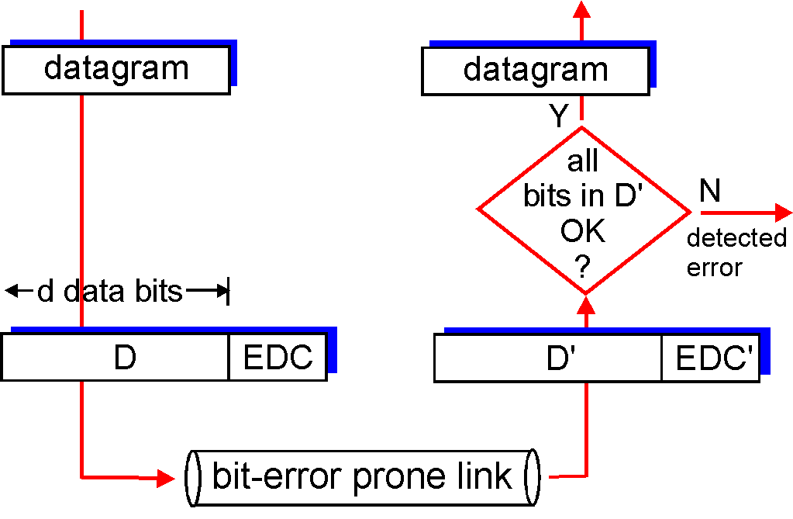

Error detection
EDC= Error Detection and Correction bits (redundancy)
D = Data protected by error checking, may include header fields
Error detection not 100% reliable!
protocol may miss some errors, but rarely
larger EDC field yields better detection and correction
otherwise

Slide 12
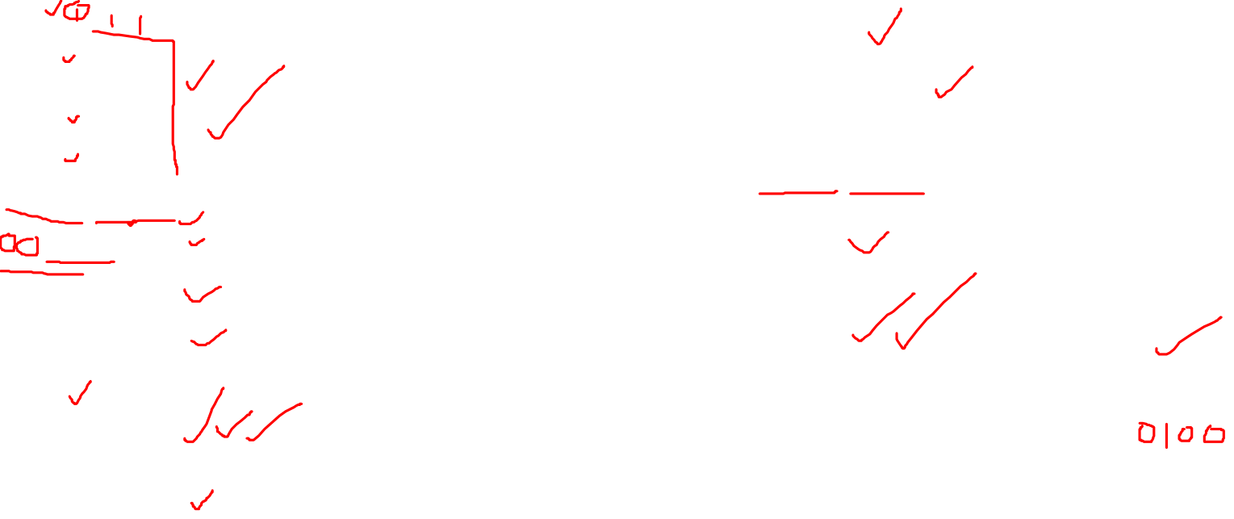
Internet checksum (review)
1100 0010 1100 1000 ------ 100010
0010 0010 ------ 0100
Flip it 1011 and send it with code
00100010 1011 ------------- 00101101
0010 1101 ------ 1111
Flip it, it will become 0000

Slide 13
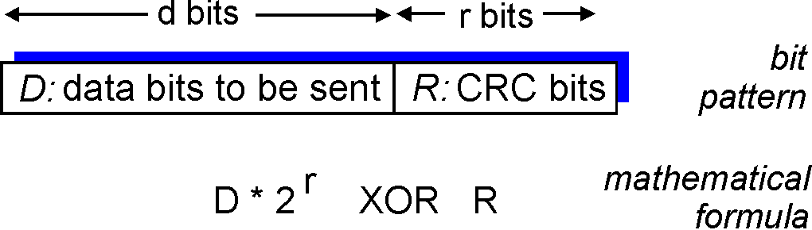
Cyclic redundancy check
more powerful error-detection coding
view data bits, D, as a binary number
choose r+1 bit pattern (generator), G
goal: choose r CRC bits, R, such that
<D,R> exactly divisible by G (modulo 2)
receiver knows G, divides <D,R> by G. If non-zero remainder: error detected!
can detect all burst errors less than r+1 bits
widely used in practice (Ethernet, 802.11 WiFi, ATM)

Slide 14
CRC example
Suppose sender wants to transmit: Message = 11100101 polynomial = 11011 lets see how to calculate CRC and how it works at receiver end

Slide 15
